Slide 1
Project 2
HDB Resale Price Prediction
DSIF9 Team 4
Ho Kit Fai
Zhu Ye (Juliana)
Ng Zeng Di
Wong Keng Hui

Slide 2
Agenda
Background Situation
Approach on Data Cleaning & EDA
Feature Engineering & Modelling
Model Evaluation
Conclusion and Recommendation

Slide 3
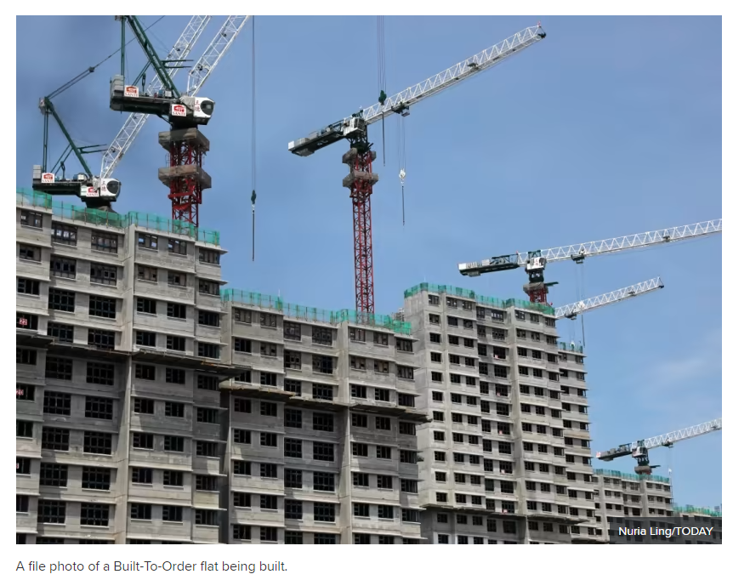
How many applicants were successful in their BTO flat application at their first attempt?
December 1, 2022
https://www.todayonline.com/singapore/20-24-first-time-bto-applicants-mature-estates-succeed-first-try-less-2-need-more-5-tries-desmond-lee-2060306

Slide 4

How many applicants were successful in their BTO flat application at their first attempt?
December 1, 2022
https://www.todayonline.com/singapore/20-24-first-time-bto-applicants-mature-estates-succeed-first-try-less-2-need-more-5-tries-desmond-lee-2060306
Notes:
The majority of the residential housing in Singapore are HDB flats, which are home to approximately 78.7% of the resident population. This also contributes to the large size of the resale market of HDB flats in Singapore. Price is definitely a significant factor that buyers, sellers or agents would take into account.
A buyer who have children may want to know how much it costs to choose a relative new HDB flat that is near both a primary school and a train station. A seller may need to know how much he/she can get for selling a 100-sqm, high-floor HDB flat, which is near a shopping mall.

Slide 5
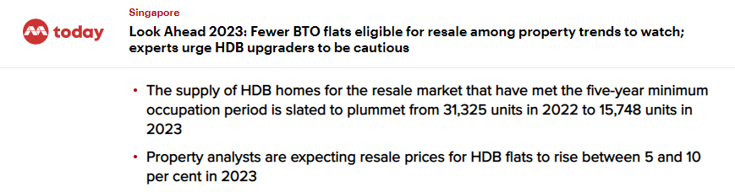
High resale price for HDB
January 4, 2023
https://www.todayonline.com/singapore/look-ahead-2023-bto-flats-resale-home-prices-2083416
Notes:
First-time flat owners hoping to sell their homes this year will have less competition, with close to 50 per cent fewer flats completing their minimum occupation period in 2023 compared to last year.

Slide 6
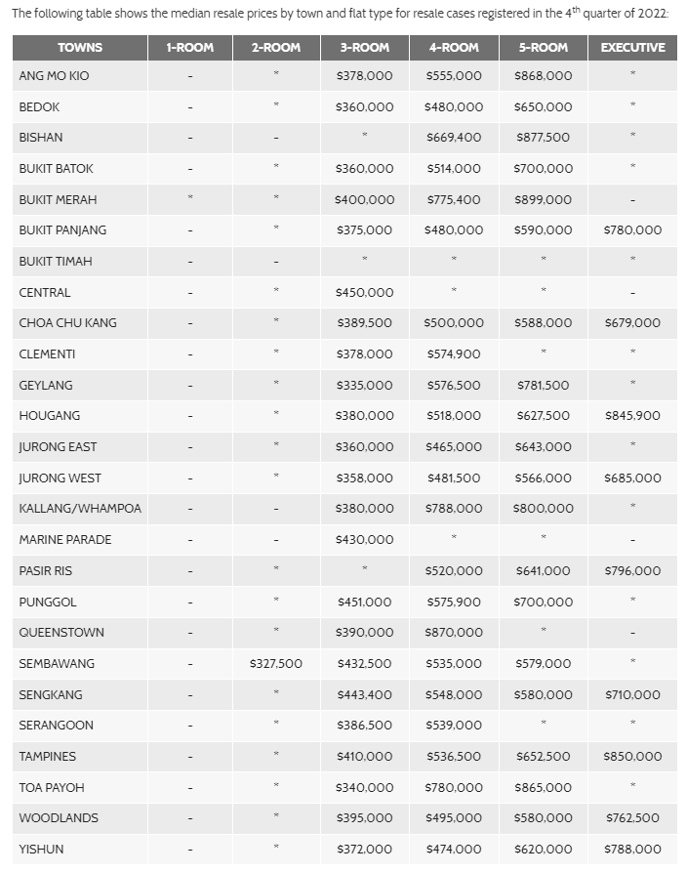
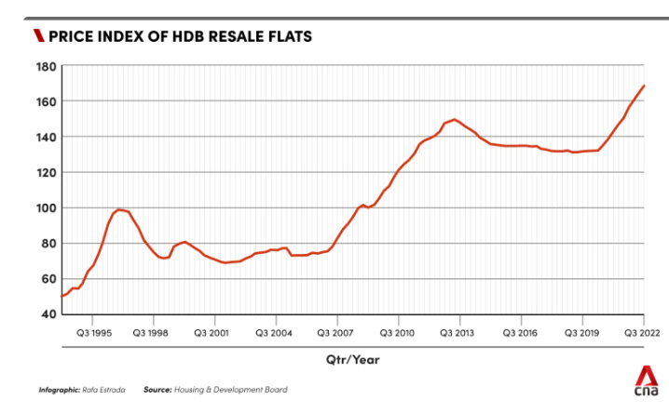
High resale price for HDB
Q3 2022 more than 160 price index
https://www.hdb.gov.sg/residential/selling-a-flat/overview/resale-statistics
Notes:
First-time flat owners hoping to sell their homes this year will have less competition, with close to 50 per cent fewer flats completing their minimum occupation period in 2023 compared to last year.

Slide 7
Not easy to apply for BTO flat due to low successful application rate
Increasing resale price for HDB
Lesser HDB resale supply added in 2023
Resolution
Find out what features have an influence on the market resale value of HDB flats
Aim to predict the resale price of an HDB flat for Buyer and Seller make better decision on getting the right price for transaction.
Situation
Resolution

Slide 8
Approach for Data Cleaning
Features with Missing Data
Feature Selection
Dropped features* based on:
Presence of an existing substitutable feature or high correlation with another feature
Sparsity or lack of variance (all 1s or Ys)
Being used in creating new features
Limited correlation with resale price
Mall_Nearest_Distance'
'Mall_Within_500m', ‘Mall_Within_1km',
'Mall_Within_2km', 'Hawker_Within_500m', 'Hawker_Within_1km', 'Hawker_Within_2km'
Replace null values with 0
Replace null values with 2000m
*Dropped features: Tranc_YearMonth, block, street_name, storey_range, floor_area_sqm, lease_commence_date, lower, upper, mid, full_flat_type, address, residential, postal, Latitude, Longitude, planning_area, mrt_name, mrt_latitude, mrt_longitude, bus_stop_name, bus_stop_latitude, bus_stop_longitude, pri_sch_name, pri_sch_latitude, pri_sch_longitude, sec_sch_name, sec_sch_latitude, sec_sch_longitude
Notes:
I’ll go through some of the main steps that we took for data cleaning and exploratory data analysis (otherwise known as EDA).
For data cleaning, we first looked at missing data and noticed that they were primarily in features related to the number of malls and hawkers located within a certain distance from the housing unit. For mall nearest distance, the blank values should contain the distance of the nearest mall, even if it's further than 2km. For these, we imputed null values with 2000m.
For the remaining features indicated on the slide, we imputed them with 0 because upon inspection there aren’t supposed to be values in those cells.
Next we also identified variables that should be further cleaned, based on a few considerations:
- Whether they had another variable that could be substituted
- Low variance (perhaps 90% of the feature was 1s or Yeses)
- Features used in the engineering of new ones (later on)
- Those with close to 0 correlation with resale price.
These 28 variables are listed in the slide and were dropped from the main dataset.

Slide 9
Approach for Exploratory Data Analysis (EDA)
1
Descriptive statistics
2
Change data types to better suit linear regression
3
Examine dependent variable
4
Relationships between variables and with resale price
5
Test hypothesis on whether different unit types are predicted by different factors
Notes:
Here is a summary of the main steps taken for exploratory data analysis.
We ran descriptive statistics to understand the overall dataset, changed data types to convert variables into a form that would better be used for linear regression.
Next we examined the dependent variable in more detail to see its skew and check for outliers.
We did the same for the categorical and numerical variables.
Lastly we had a hypothesis that the factors predicting housing prices might differ based on the housing unit type because the profile of buyers are not the same. We tried finding supporting evidence for this hypothesis via EDA.

Slide 10
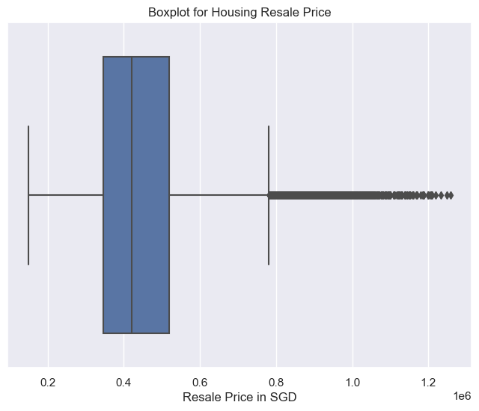
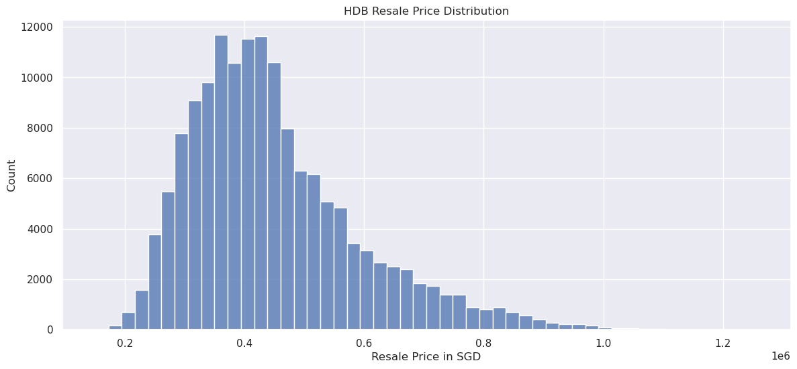
EDA: Examining ‘Resale Price’
Observations:
Right-skewed indicating a small number of homes were sold at exceptionally high prices
The box-plot shows outliers priced above SGD 800,000
Choose not to exclude outliers since they reflect actual market conditions
Notes:
Resale price, our dependent variable, is skewed right and has outliers, which are housing units mostly priced above 800K. One thing that we thought about was whether or not to handle outliers — here, based on external research and domain knowledge, we know there have been recent trends of high-resale transactions among HDB flats. These “outliers” are true reflections of the actual housing landscape. So we choose to keep them in the model.

Slide 11
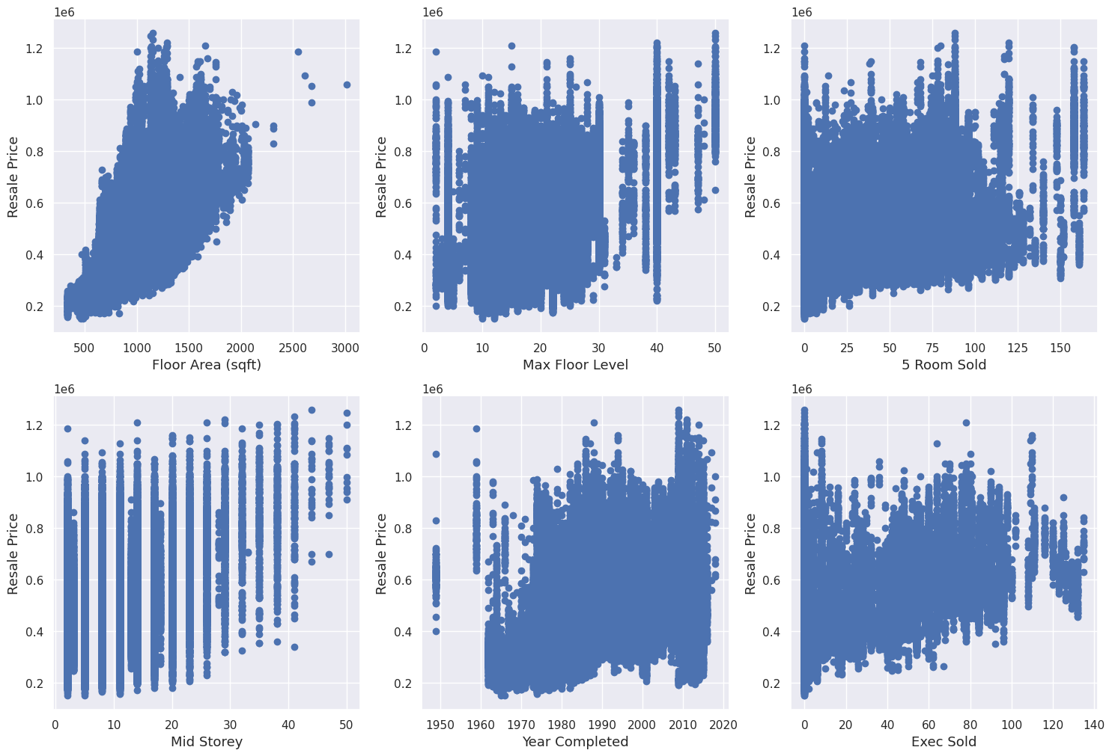
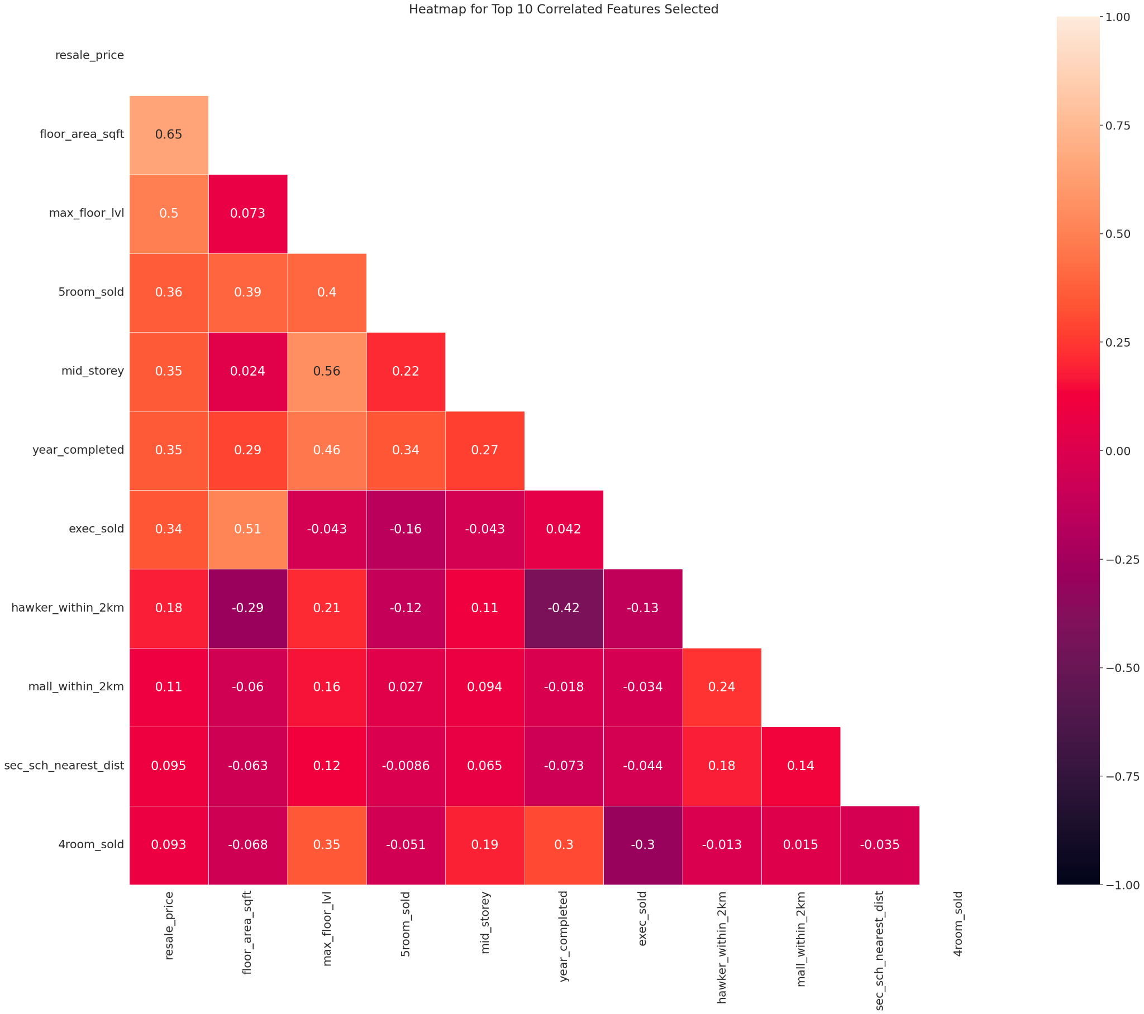
EDA: Examining Relationships among Numerical Features
Scatterplots and correlation heatmaps were used to study each feature’s relationship with resale price and other predictor variables (i.e. multicollinearity).
Not all numerical features had linear relationships with resale price. We note which ones did not, and think about transforming them so that they will make sense if included in a linear regression model.
High multicollinearity creates interpretation problems and increases risk of overfitting for linear regression models. We consider combining variables and dropping the ones that have substitutes.
Notes:
Numerical variables were analysed using a scatterplots and correlation heatmaps to look at their relationship with the dependent variable and with each other. For the former, we are looking for a linear relationship so that our model assumptions can be met. For the latter, we’re looking to exclude or manage variables that do not have high correlation with each other, otherwise known as multicollinearity. This will lead to issues interpreting coefficients in the linear regression model and potentially cause overfitting.

Slide 12
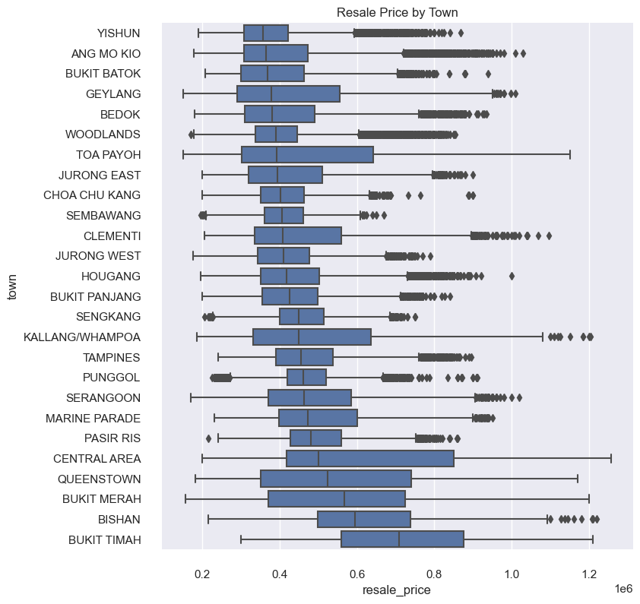
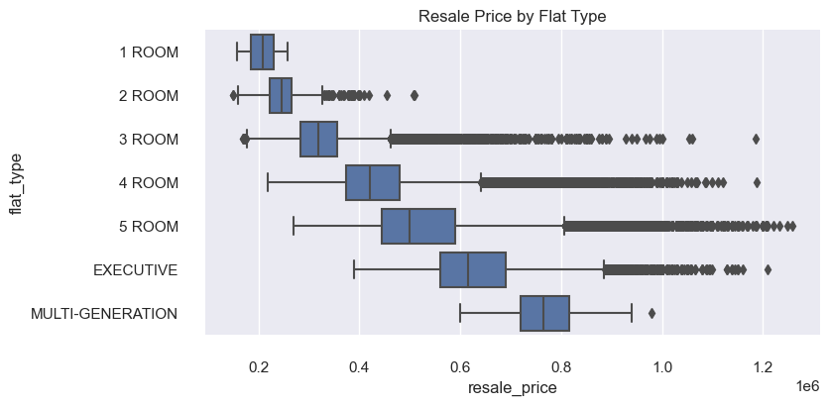
EDA: Examining Categorical Variables
Boxplots and bar charts address some of our initial hypotheses for categorical variables such as town and flat type:
Whether they vary with resale price
The median resale prices for each category
Distribution and presence of outliers
Notes:
Categorical variables were studied using boxplots, to see which categories were associated with higher or lower resale prices, as well as their skew/distribution. This will allow us to check if our predictions perform similarly.

Slide 13
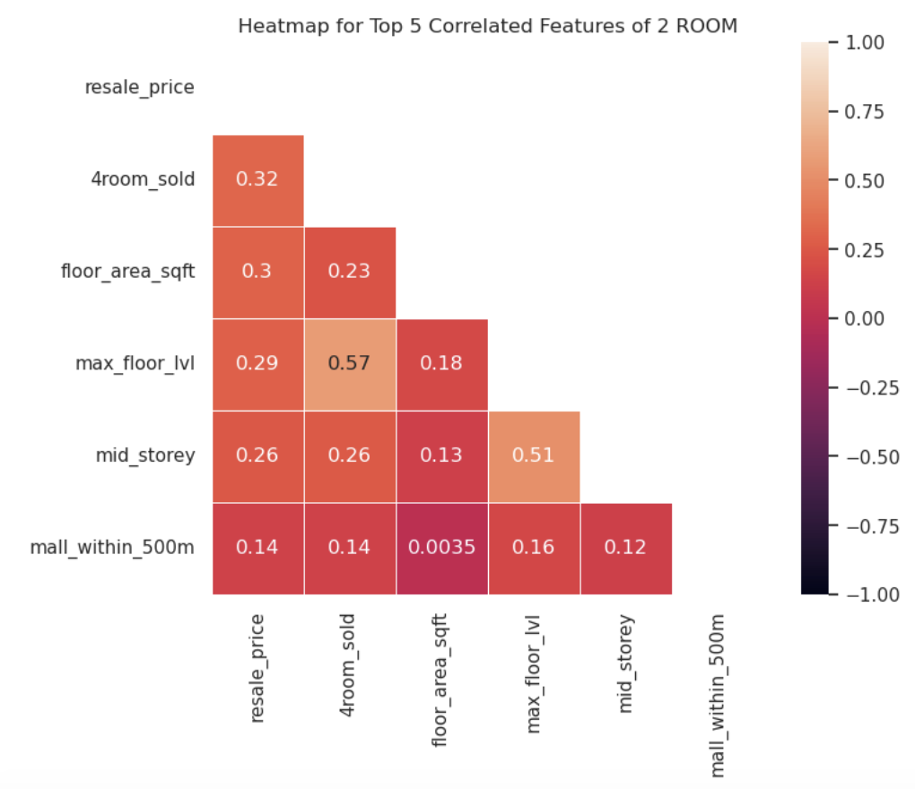
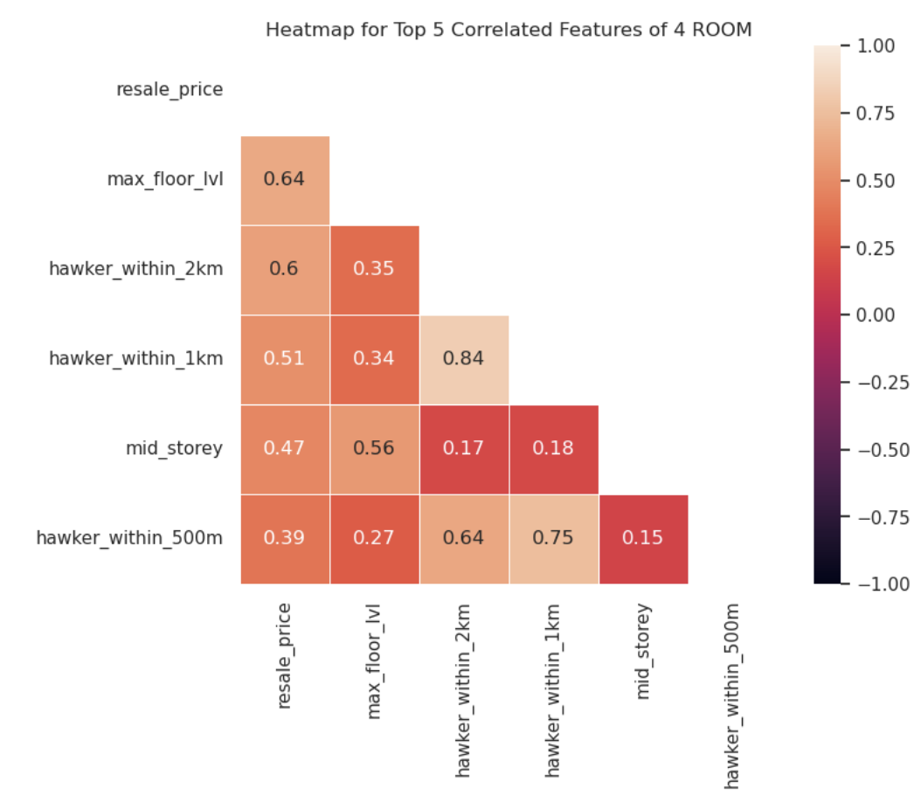
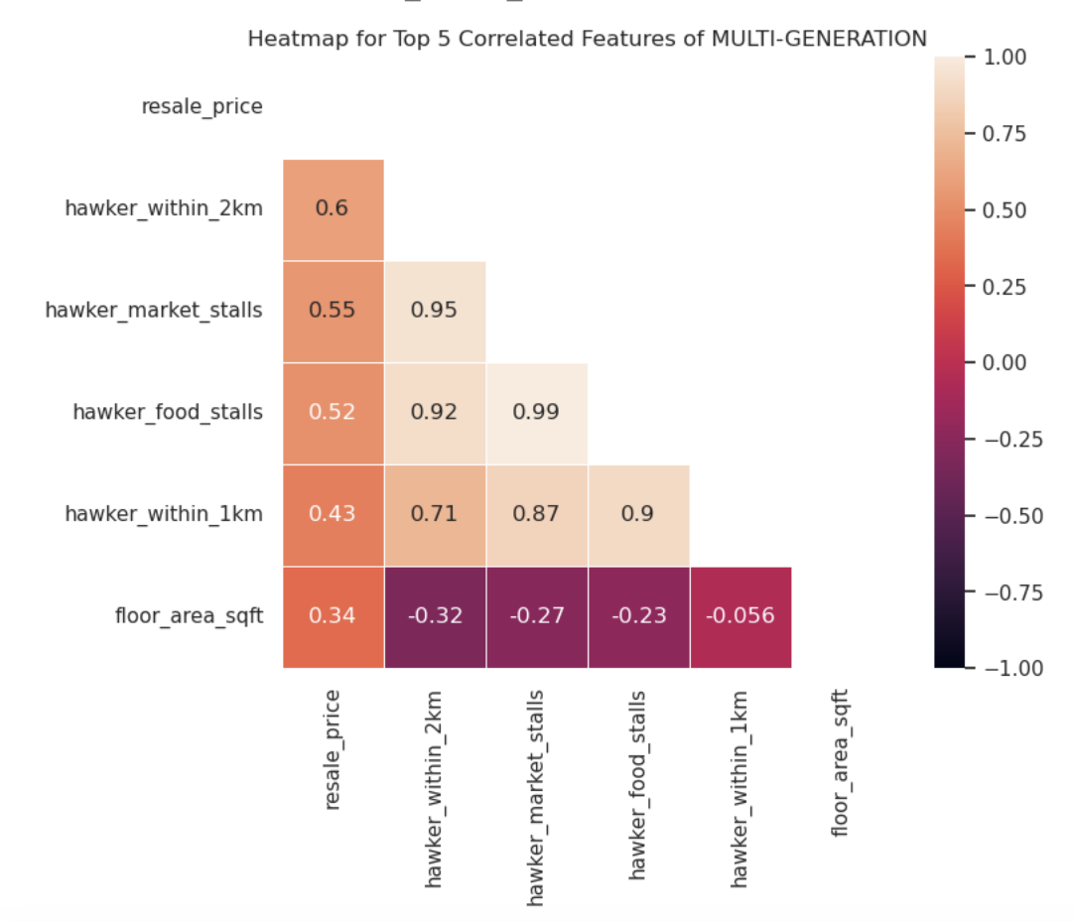
EDA: Correlation with Resale Price by Flat Type
The top 5 correlated features by room type (showing a sample of rooms) are quite different.
Should we do different models for each room type to predict resale prices?
Notes:
Lastly, as mentioned earlier, we wanted to test our hypothesis on whether each unit types might be associated different predictors. Based on the correlation heatmap, this hypothesis is supported. In the next section on preprocessing and modelling, Juliana will talk about how she used unit-specific models to predict resale price.

Slide 14
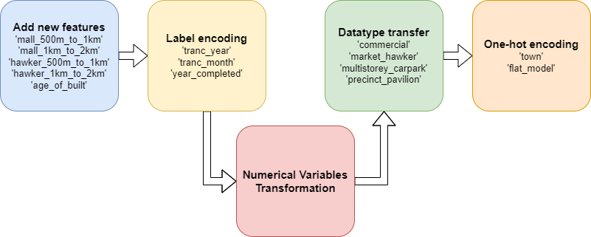
Feature Engineering Steps

Slide 15
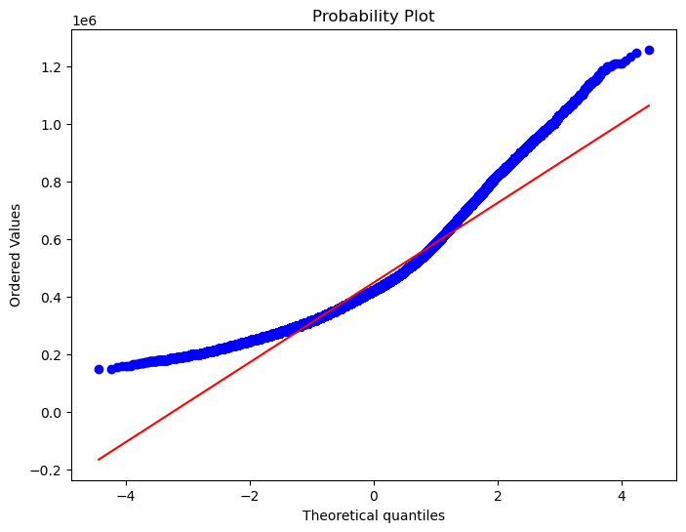
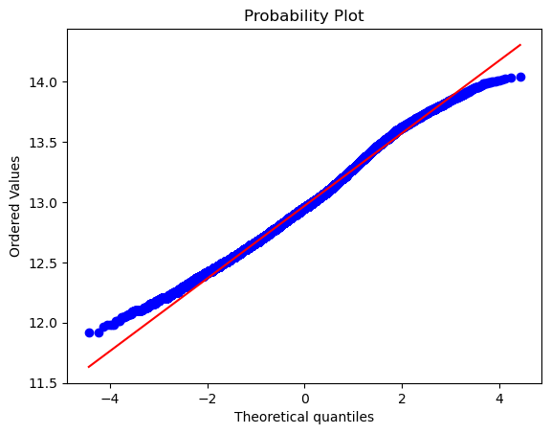
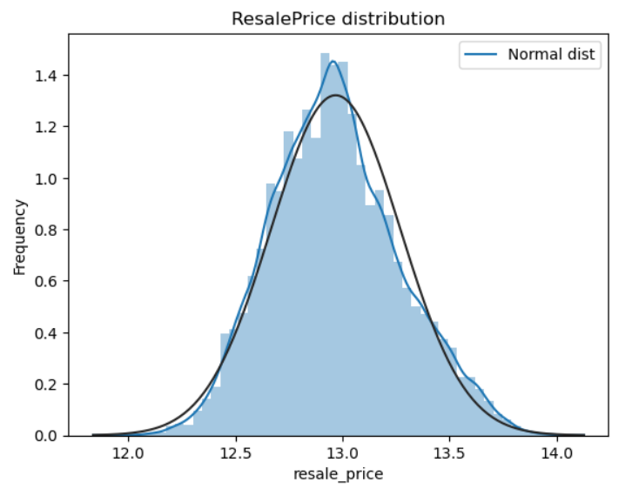
Feature Engineering: Numerical Variables Transformation
Original y_train
Transformed y_train
Skew in numerical features
X | Skew
other_room_rental | 79.521010
multigen_sold | 50.660446
1room_sold | 43.330977
1room_rental | 41.446940
2room_rental | 27.034726
3room_rental | 22.261928
studio_apartment_sold | 15.331996
2room_sold | 8.680007
mall_within_2km | 4.628154
mall_1km_to_2km | 3.872227

Slide 16
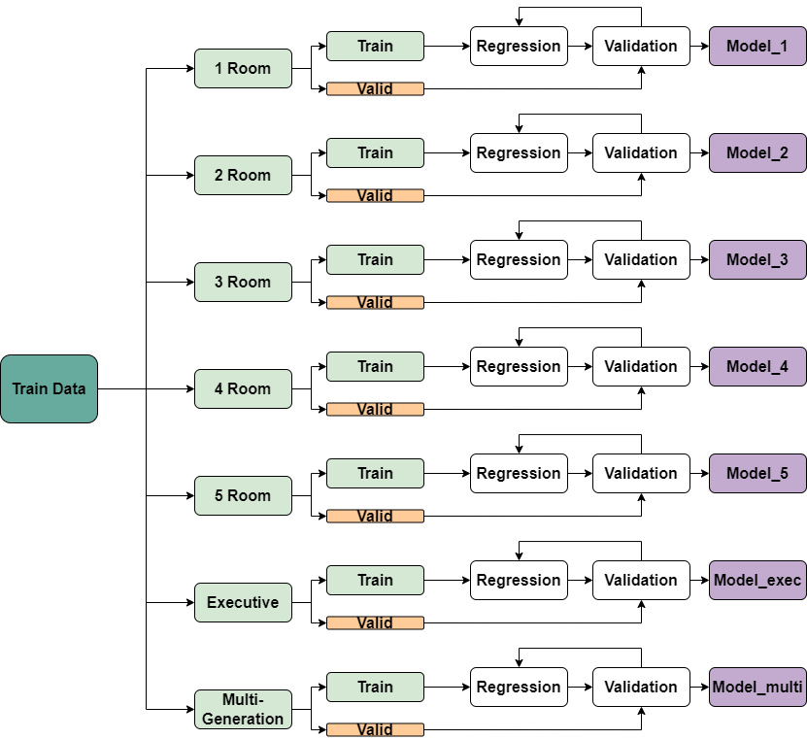
Modelling Methodology: Split Models for Different Flat Types

Slide 17
Summary of Models for Different Flat Types
Model Name | Flat Type | Regression Model | Normalized RMSE on Validation Set
Model_1 | 1 ROOM | LinearRegression | 0.06683
Model_2 | 2 ROOM | LinearRegression | 0.07313
Model_3 | 3 ROOM | LASSORegression | 0.08614
Model_4 | 4 ROOM | LinearRegression | 0.07959
Model_5 | 5 ROOM | RidgeRegression | 0.08074
Model_6 (Model_exec) | EXECUTIVE | LinearRegression | 0.07393
Model_7 (Model_multi) | MULTI-GENERATION | LinearRegression | 0.05287

Slide 18
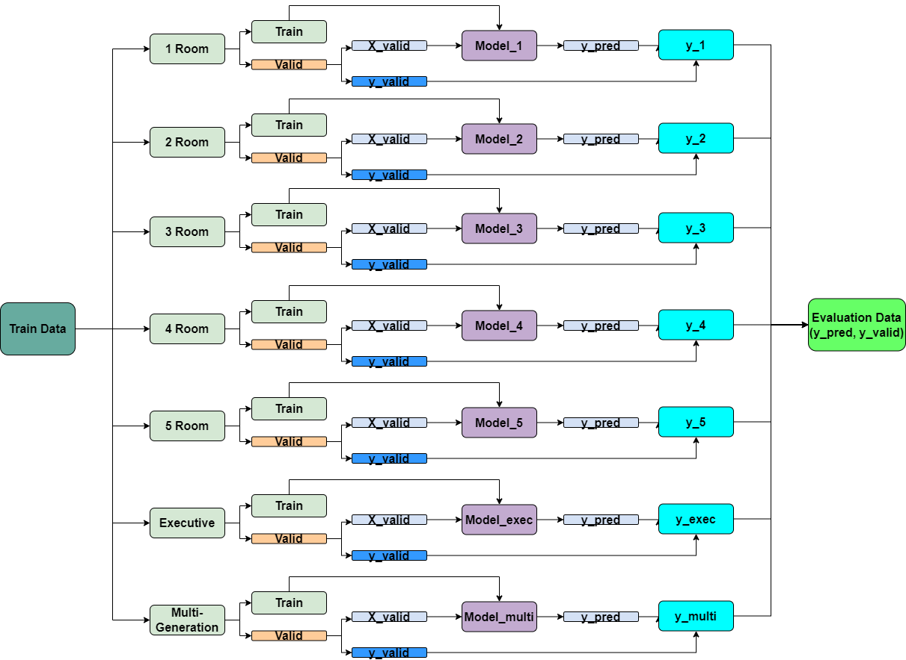
Model Evaluation with Validation Set

Slide 19
Model Evaluation Results
Baseline Model - Computation of Mean Resale Price
RMSE of Resale price: 143307.1$
Mean Resale Price: 449161.5$
Machine Learning Model - Amalgamation of 7 models
RMSE of Resale price: 39415.3$
R2 of Resale Price: 0.928
It’s a marked improvement from the Baseline in terms of predictive capability
Notes:
We first create a baseline model by taking the mean of the resale price of all the training data
The RMSE of the model is around 143k, not too shabby already. However, to give a perspective, the R^2 is a ridiculous number, it means our baseline model doesn’t explain any of the variable at all
From the 7 models which Juliana explained, we yield an RMSE of 39k, and an R^2 of 0.928. This means our model is able to explain 93% of the variations. It is a marked improvement.
However, all these metrics should be accompanied by a sanity check

Slide 20
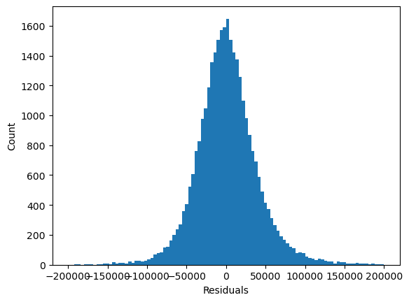
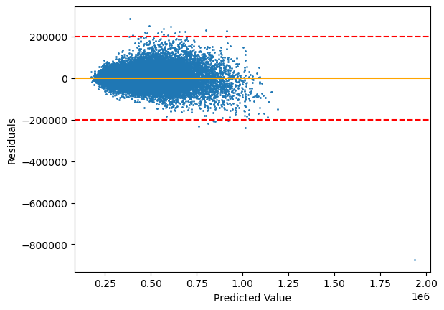
Model Evaluation Results
Normality Check (Histogram of Residuals)
Equal Variance Check (Randomness in Residuals)
Histogram of Residuals - looks normally distributed, we’re good
Randomness in Residuals - It is randomly distributed and not fanning out, however, there are a few outliers beyond +/-200000, let’s zoom in
Notes:
In Linear Regression, we should always stick to the LINE guidelines.
Keng Hui explored the L - Linearity, and I - Independence between the variable previously.
The histogram of residuals is normally distributed, we comply with N- Normality Check
The Equal Variance Check indicates that the residuals are randomly distributed, and not fanning out, with a few outliers beyond +/- 200000, we shall explore that

Slide 21
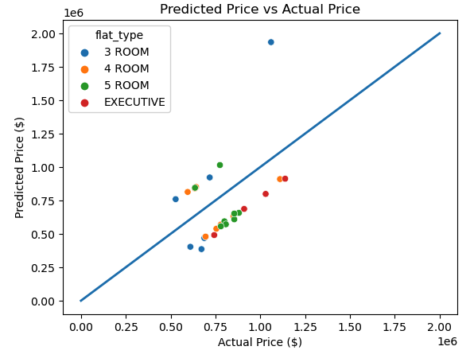

Model Evaluation Results
We have 26 of such cases. This implies that our the models above requires further tuning
Notes:
Filtering the model, we find 26 of such cases.
Plotting the actual vs predicted price, we can see that they vastly under/over estimate the prices. While there is only 26 errors out of 150k data points, it still implies that our models requires further tuning. It would not be acceptable for us to mislead our client during a HDB transaction and result in losing a transaction

Slide 22
Conclusion and Recommendation
Positively correlated features to the resale price for each flat type
 | 1 Room | 2 Room | 3 Room | 4 Room | 5 Room | Exec | Multi
1st | tranc month | 4room sold | max floor lvl | max floor lvl | hawker within 2km | hawker within 2km | hawker within_2km
2nd | mid storey | floor area sqft | floor area sqft | hawker within 2km | max floor lvl | hawker within 1km | hawker market stalls
3rd | tranc year | max floor lvl | mid storey | hawker within 1km | hawker within 1km | floor area sqft | hawker food stalls
4th | - | mid storey | hawker within 2km | mid storey | hawker within 500m | hdb age | hawker within 1km
5th | - | mall within 500m | mall within 2km | hawker within 500m | mid storey | affiliation | floor area sqft
Notes:
identify the top 5 features that were positively correlated to the resale price for each flat type,

Slide 23
Conclusion and Recommendation
Positively correlated features to the resale price for each flat type
 | 1 Room | 2 Room | 3 Room | 4 Room | 5 Room | Exec | Multi
1st | tranc month | 4room sold | max floor lvl | max floor lvl | hawker within 2km | hawker within 2km | hawker within_2km
2nd | mid storey | floor area sqft | floor area sqft | hawker within 2km | max floor lvl | hawker within 1km | hawker market stalls
3rd | tranc year | max floor lvl | mid storey | hawker within 1km | hawker within 1km | floor area sqft | hawker food stalls
4th | - | mid storey | hawker within 2km | mid storey | hawker within 500m | hdb age | hawker within 1km
5th | - | mall within 500m | mall within 2km | hawker within 500m | mid storey | affiliation | floor area sqft
Notes:
5 Room, Executive, or Multi-generation flat, the number of hawkers within 2km is a key factor to consider. Historical data suggests that flats located in areas with more hawkers within 2km tend to command higher prices.

Slide 24
Conclusion and Recommendation
Positively correlated features to the resale price for each flat type
 | 1 Room | 2 Room | 3 Room | 4 Room | 5 Room | Exec | Multi
1st | tranc month | 4room sold | max floor lvl | max floor lvl | hawker within 2km | hawker within 2km | hawker within_2km
2nd | mid storey | floor area sqft | floor area sqft | hawker within 2km | max floor lvl | hawker within 1km | hawker market stalls
3rd | tranc year | max floor lvl | mid storey | hawker within 1km | hawker within 1km | floor area sqft | hawker food stalls
4th | - | mid storey | hawker within 2km | mid storey | hawker within 500m | hdb age | hawker within 1km
5th | - | mall within 500m | mall within 2km | hawker within 500m | mid storey | affiliation | floor area sqft
Notes:
3 Room or 4 Room flat, you should pay close attention to the maximum floor level of the building as flats with higher maximum floor levels are often more expensive. The max floor as newer buildings have higher floor

Slide 25
Conclusion and Recommendation
Positively correlated features to the resale price for each flat type
 | 1 Room | 2 Room | 3 Room | 4 Room | 5 Room | Exec | Multi
1st | tranc month | 4room sold | max floor lvl | max floor lvl | hawker within 2km | hawker within 2km | hawker within_2km
2nd | mid storey | floor area sqft | floor area sqft | hawker within 2km | max floor lvl | hawker within 1km | hawker market stalls
3rd | tranc year | max floor lvl | mid storey | hawker within 1km | hawker within 1km | floor area sqft | hawker food stalls
4th | - | mid storey | hawker within 2km | mid storey | hawker within 500m | hdb age | hawker within 1km
5th | - | mall within 500m | mall within 2km | hawker within 500m | mid storey | affiliation | floor area sqft
Notes:
Floor area as we know must surely appear as one of the significant factor affecting price

Slide 26
Conclusion and Recommendation
Positively correlated features to the resale price for each flat type
 | 1 Room | 2 Room | 3 Room | 4 Room | 5 Room | Exec | Multi
1st | tranc month | 4room sold | max floor lvl | max floor lvl | hawker within 2km | hawker within 2km | hawker within_2km
2nd | mid storey | floor area sqft | floor area sqft | hawker within 2km | max floor lvl | hawker within 1km | hawker market stalls
3rd | tranc year | max floor lvl | mid storey | hawker within 1km | hawker within 1km | floor area sqft | hawker food stalls
4th | - | mid storey | hawker within 2km | mid storey | hawker within 500m | hdb age | hawker within 1km
5th | - | mall within 500m | mall within 2km | hawker within 500m | mid storey | affiliation | floor area sqft
Notes:
Which story the flat is located in appears five times from 1 room to 5 room (do we know which storey)
linear relationship between the selected features in the dataset and the HDB resale price was weak, while the multicollinearity among the selected features was strong. This made it difficult to fit the data to a single linear model and interpret the coefficients effectively.

